Slide 1
HEART ATTACK PREDICTION
BY -
2103A51580 – P.PREETHAM NAIK
2103A51236 – N.RAMCHARAN
2102A51500 – V.SHIVA SHARATH
Under the esteemed guidance of Mr. S Naresh Kumar

Slide 2
Overview
The project Heart attack prediction using AIML (Artificial Intelligence and Machine Learning) involves developing a model that can analyze various health factors and predict the likelihood of a person having a heart attack in the future.
The model is trained on as dataset of health records and other factors, such as age, gender, blood pressure, cholesterol levels, previous heart conditions and etc. The resulting model can be used to identify individuals who are at high risk of a heart attack and take preventive measures, such as lifestyle changes and medication.

Slide 3
PROBLEM STATEMENT
Heart attack prediction is a critical healthcare problem that aims to predict the likelihood of a person having a heart attack based on their health parameters. Heart attack, also known as myocardial infarction, is a life-threatening condition that occurs when the blood flow to the heart is blocked, causing damage to the heart muscle.
The goal of heart attack prediction is to identify individuals who are at high risk of having a heart attack and take preventive measures to reduce their risk. Predictive models can be developed using various machine learning techniques that take into account various factors such as age, gender, medical history, lifestyle habits, and physiological parameters like blood pressure, cholesterol levels, and blood glucose levels.

Slide 4
LITERATURE SURVEY: SURVEY DONE BY US
“N Madhusudan Nayak, Maruti M Kamat, Ashwini B.S, Raksha N Pai Information Science and Engineering, Canara Engineering collegeBenjanapadavu, India”.
“Nikunj Patel, Princekumar Patel and Nehal Patel “Heart Attack Detection and Heart Rate Monitoring Using IoT.” International Journal of Innovations & Advancement in Computer Science (IJIACS) 7.4(2018):2347-8616.”
“Gowrishankar, S., M. Y. Prachita, and Arvind Prakash. "IoT based Heart Attack Detection, Heart Rate and Temperature Monitor."”

Slide 5
“Aboobacker, Arith ,Balamurugan, Deepak, Sathish “Heartbeat Sensing and Heart Attack Detection using Internet of Things: IoT” International Journal of Engineering Science and Computing April 2017.”
“ R. Bhuvaneswari and K. Kalaiselvi, “Naïve Bayesian Classification Approach in Healthcare Applications”, International Journal of computer Science and Telecommunication”, vol. 3, no. 1, pp. 106-112, Jan 2012.”

Slide 6
““Mayur, Suraj, Shubham, Nikhil “Heart Attack Detection using Android Phone“ International Journal For Engineering Applications And Technology.”
"Machine learning models for prediction of acute coronary syndrome: An overview“.
“Mallick, Bandana, and Ajit Kumar Patro. "Heart rate monitoring system using finger tip through arduino and processing software." International Journal of Science, Engineering and Technology Research (IJSETR) 5.1 (2016): 84-89.”

Slide 7
“Yadav, Yashasavi, and ManasaGowda. "Heart Rate Monitoring and Heart Attack Detection using Wearable Device." International Journal for technical research and Application (2016).”“
“Lei Song, Yongcai Wang, Ji-Jiang Yang, Jianqiang Li, Health Sensing by Wearable Sensors and Mobile Phones : A Survey, 2015.”
“Arulananth.T.S, B. Shilpa, Fingertip based heart beat monitoring system using embedded systems, 2017”.

Slide 8
“K.VembandasamyP 1 PR ,R R.SasipriyaP 2 Pand E.DeepaP 3 P 1 PDepartment of computer science, PSG college of arts and science, Coimbatore, Tamilnadu, India.”
“Md. Ashrafuzzaman, MdMazaharulHuq, Chandan Chakraborty, Md. Rafi Monjur Khan, TaslimaTabassum, Rashedul Hasan. "Heart attack detection using smart phone." International Journal Of Technology Enhancements And Emerging Engineering Research 1.2013 (2013): 23-27.”
“Ajitha, U., et al. "IOT Based Heart Attack Detection and Alert System." International Journal of Engineering and Management Research (IJEMR) 7.2 (2017): 285-288.”

Slide 9
“C. Ordonez, “Programming the K-Means Clustering Algorithm in SQL,” Proc. ACM Int’l Conf. Knowledge Discovery and Data Mining, pp. 823-828, 2004.”
“Apruv Patel, 2kunjan D. khatri, 3Smit Kiri, 4Kathan Patel Research Scholars, Department of computer engineering, Vishwakarma Government Engineering College Ahmedabad, India.”
“A.Dutta, A.Banerjee, A. Bose, A. Audd y, T.K.Rana, Swarasree Bhattacharya, Heart Tracer-The Route To Your Heart, 2017.”

Slide 10
Existing Systems
There are several existing systems in the field of AIML (Artificial Intelligence and Machine Learning) that are designed to predict the likelihood of a heart attack. There are some existing models which can able to take images as dataset and predict the output. Some of the most commonly used systems include:
Framingham Heart Study: This is one of the oldest and most widely used systems for predicting heart attack risk. It is based on data collected from the Framingham Heart Study, a long-term study of heart disease risk factors in the United States.

Slide 11
SCORE (Systematic COronary Risk Evaluation): SCORE is a system developed by the European Society of Cardiology for assessing the risk of developing cardiovascular disease. It takes into account several factors, including age, sex, smoking status, blood pressure, and cholesterol levels.
QRISK: This is a system developed in the United Kingdom that uses data from the UK General Practice Research Database to predict the risk of developing heart disease. It takes into account factors such as age, sex, ethnicity, smoking status, blood pressure, cholesterol levels, and family history of heart disease.

Slide 12
Proposed System
Our Heart attack prediction system model analyses a large amount of dataset taken from 303 peoples in which we include their health factors and parameters such as age, gender, chest pain(which is scaled to 0 to 3 meaning low to extreme respectively), cholesterol, maximum blood pressure(maxi), blood pressure before meals (which we give values as 0 and 1, if bp is less than 120 mmHg then fbs value is assigned as 0 or else fbs value is assigned as 1) and blood flow rate while resting. By analysing their health parameters and various factors the model we trained will predict whether the person has a chance of getting heart stroke or not, if he has a chance of getting heart stroke, as our model has predicted it in early stage he may take the precautions to escape the tragedy.
Our model is trained well in many aspects and in different methodology to predict the output with precised accuracy. This application can be very useful for early detection and prevention of heart attacks. This can potentially save many lives and reduce the overall healthcare burden.

Slide 13
Objectives
Develop an accurate and efficient heart attack prediction model using artificial and machine language algorithms.
Collect and process a large amount of dataset which consists of patients health parameters.
Train your model in various aspects using machine learning algorithms.
Evaluate the performance of the model using appropriate metrics such as accuracy, precision, and recall.

Slide 14
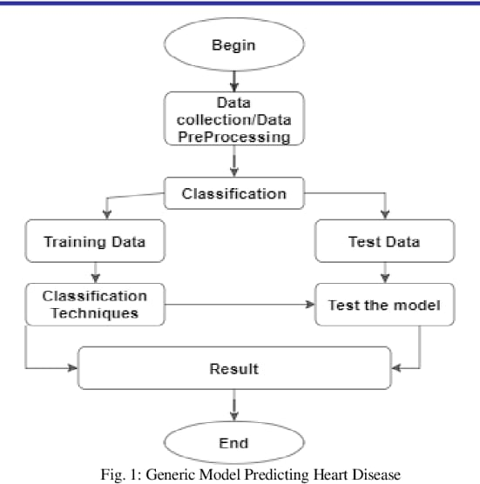
Overall architecture

Slide 15
Dataset Description
The dataset used in this project is a collection of health factors of patients. The model which we trained takes those parameters as input and predict the outcome.
The following factors are columns of the dataset:
Age – patient age
Sex – patient gender
Cp – Chest pain level of patient
Resting – Blood flow rate of patient while he is resting
Chol – Cholesterol levels of patient
Fbs – Level of Blood pressure of patient before meals
Maxi – Maximum blood pressure of patient

Slide 16
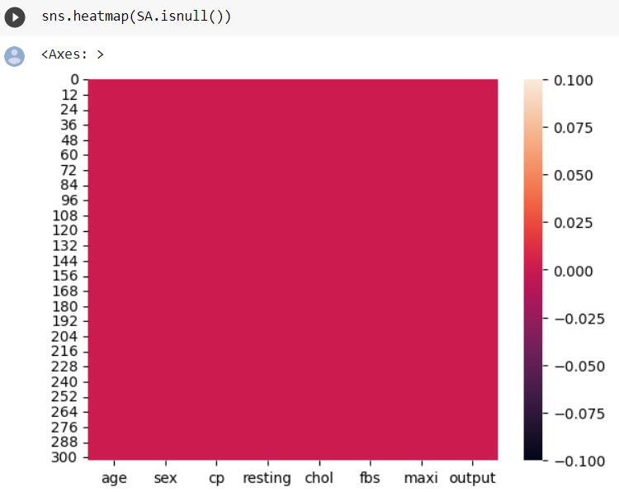
DATA VISUALISATION heat map
performance of a machine learning model by displaying the confusion matrix as a heatmap.

Slide 17
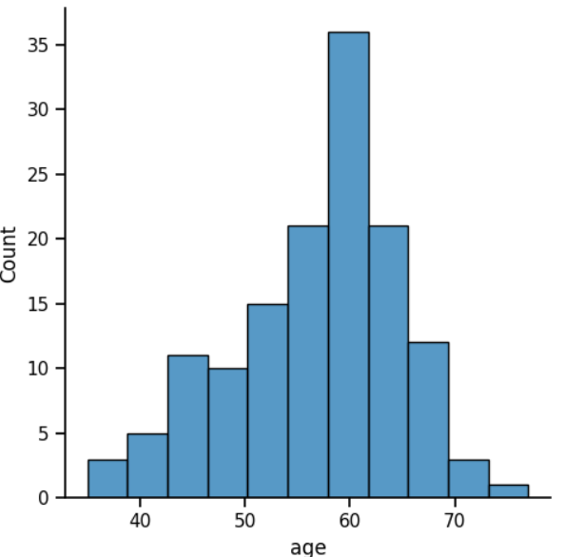
DATA VISUALISATION bar graph
By analyzing the above bar graph, we can gain insights into which features are most relevant heart detection and potentially improve the accuracy of the language detection model.

Slide 18
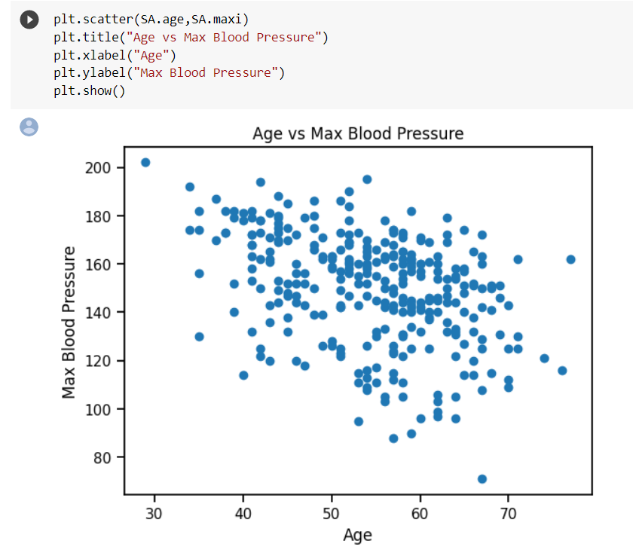
DATA VISUALISATION scatter plot
The data points are plotted on the scatter plot, we observe clusters of points in the specific regions of the plot.

Slide 19
Procedure to solve the given problem
Data collection :The first step is to collect a dataset of health parameters of several patients. This can be done by web scraping, using publicly available datasets, or collecting data from social media platforms

Slide 20
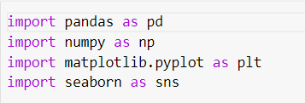
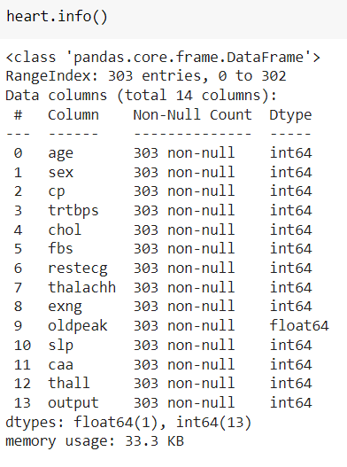
Procedure to solve the given problem
Data cleaning and pre-processing:

Slide 21

Procedure to solve the given problem
Model selection:
A suitable machine learning algorithm is chosen as the predictive model to classify heart attack prediction.

Slide 22
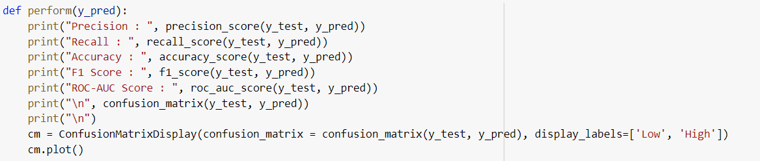
Procedure to solve the given problem
Model training and testing:

Slide 23
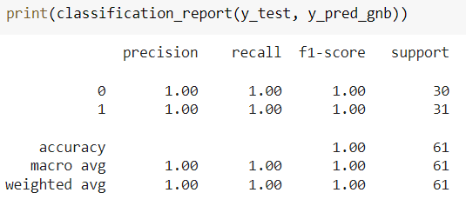
Procedure to solve the given problem
Model evaluation and analysis:

Slide 24
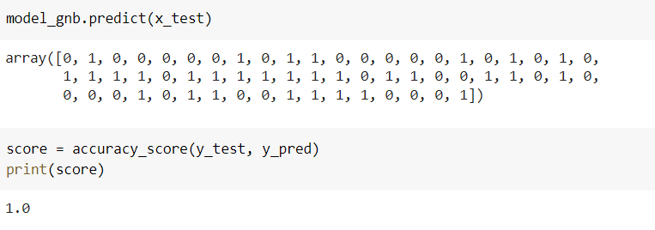
Procedure to solve the given problem
Deployment:

Slide 25
Software Description
Python
Pandas
Numpy
Scikit-Learn
Matplotlib
Seaborn

Slide 26
Results and Discussion
The results of the Heart Attack Prediction project show that the model achieved an accuracy of 99.% on the testing set, indicating that it can effectively and precisely predict whether the patient may had a chance of getting a heart stroke. The dataset used in this project consisted of text data from various sources, including social media, news articles, and websites. The dataset was preprocessed by converting the data into numerical features using algorithms approach and splitting into training and testing sets
Overall, the results of this project demonstrate the effectiveness of machine learning algorithms for language detection tasks. However, it is important to note that the accuracy of the model may vary depending on the quality and quantity of data used in the model, as well as the choice of algorithm and hyperparameters. Further research and experimentation can be done to improve the model's performance and make it more robust to variations in the data.

Slide 27
Conclusion and Future Scope
In Conclusion ,our project successfully achived the objective of predicting the heart attack by same parameters using machine learning algorithm techniques. Heart attack prediction typically involves a complex analysis of multiple factors, such as age, gender, medical history, lifestyle choices, family history, and various clinical parameters. AIML, as a language, lacks the inherent capability to perform the necessary data analysis and statistical modeling required for accurate heart attack prediction.
The future scope of heart attack prediction using Artificial Intelligence Markup Language (AIML) can be quite promising. AIML, which is an XML-based markup language, is primarily used for creating chatbots and conversational agents. While AIML itself may not be the ideal choice for complex predictive modeling tasks like heart attack prediction, it can still play a role in certain aspects of the process.

Slide 28
References
https://www.kaggle.com/datasets/fedesoriano/heart-failure-prediction?resource=download
https://github.com/Infi-09/Heart-Attack-Project
https://link.springer.com/chapter/10.1007/978-981-19-3089-8_17
https://ieeexplore.ieee.org/document/9926714/

Slide 29
THANK YOU

